Slide 1
Fabric: The Secrets you need to know
Dennes Torres

Slide 2
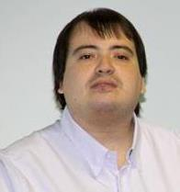






Dennes Torres Data Platform MVP (Alumni)
Dtower Software & Onyx Data
https://dtowersoftware.com
Trainer
MCT, Azure Solutions Architect, Azure Data Engineer and Azure DevOps Engineer
Malta Data Platform UG Leader
Malta
MMDPUG
https://www.facebook.com/MMDPUG
http://dennestorres.com
Dennes.Torres
@Dennes
https://br.linkedin.com/in/dennestorres
dennes@bufaloinfo.com.br
http://youtube.com/c/dennestorres

Slide 3
Query Lineage in the Lakehouse

Slide 4
Query Lineage
OPTION LABEL in SQL contains lineage information
The lakehouse breaks down in the LABEL field
Power BI sends report and semantic model id
We can query the Ids
We can use a notebook to translate the Ids

Slide 5
Query Lineage

Slide 6
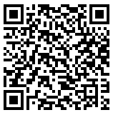
Reference: Query Lineage in Lakehouse

Slide 7
SQL Endpoint Secrets

Slide 8
SQL Endpoint
SQL Endpoint is serverless
SQL Endpoint keeps a cache
It refreshes the cache automatically

Slide 9

SQLEndpoint
Cache
OneLake

Slide 10
Consequences
The cache can be outdated
Specially noticed on the first access in the morning
The number of files affects the cache refresh

Slide 11
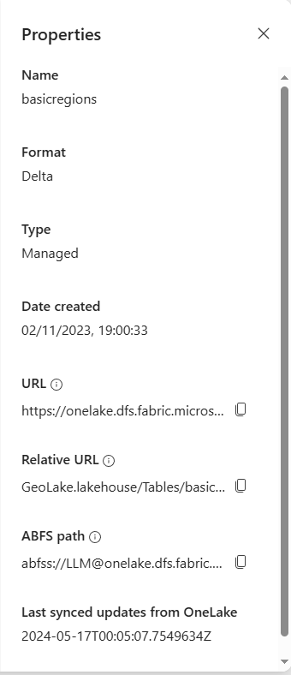
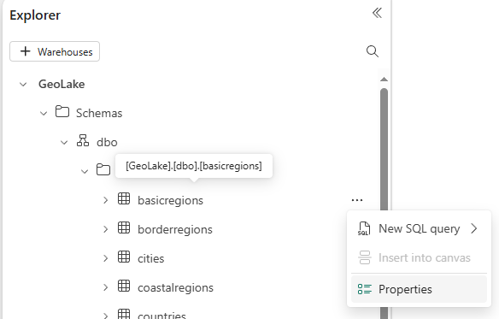

Slide 12
Solutions
A simple refresh in the lakehouse solves the problem
Triggering the refresh after a lakehouse change happens
Keeping a good maintenance routine is essential

Slide 13
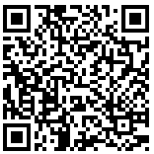
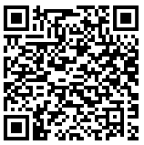
References: Lakehouse Maintenance
Video: Delta Optimization Secrets
Microsoft Fabric and Delta Table Secrets

Slide 14
SQL Endpoint Refresh

Slide 15
Notebook Schedule Disabled

Slide 16
Notebook Schedule
It’s disabled after 4 errors
No alert is generated
There is no event to capture this fact

Slide 17
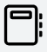
What About individual errors
Running every 5 minutes
12 executions an hour
288 executions a day
DEV
TEST
PROD
X
3 different environments: 2592
3 different notebooks: 864 executions a day
1% of errors daily: 25 errors

Slide 18
Create a report with the total of errors daily

Slide 19
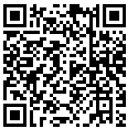
Reference: Capturing Individual Errors

Slide 20
Solution
Retrieve the schedule status using Fabric API
Use a scheduled notebook to monitor the schedule status
Use a Pipeline to send alerts

Slide 21
Monitoring Notebook Schedule

Slide 22
Infinity Notebook Loop

Slide 23
Continuous Notebook Loop
Notebooks can’t run continuously
Activator can trigger a notebook
A flag in a table can trigger the Activator
The Notebook can set the flag in the table

Slide 24
Table
Activator

Slide 25
Long Query Start Time

Slide 26
Start Time
The queries have a submit time and a start time
The difference is how long the query took to start
SQL Endpoints scale up for heavy queries
Conclusion: The starting time points how much the environment had to scale up

Slide 27
Long Query Start Time

Slide 28
Dennes Torres Data Platform MVP (Alumni)
Dtower Software & Onyx Data
https://dtowersoftware.com
Trainer
MCT, Azure Solutions Architect, Azure Data Engineer and Azure DevOps Engineer
Malta Data Platform UG Leader
Malta
MMDPUG
https://www.facebook.com/MMDPUG
http://dennestorres.com
Dennes.Torres
@Dennes
https://br.linkedin.com/in/dennestorres
dennes@bufaloinfo.com.br
http://youtube.com/c/dennestorres

